Slide 1
INDIA TOURISM REDEFINED & RE-ENGINEERED:
ITS CHANGES AND CHALLENGES
Parishmita Gogoi
Amity Institute of Travel and Tourism
Amity University, Uttar Pradesh

Slide 2
INDIA TOURISM REDEFINED &
RE-ENGINEERED..
Parishmita Gogoi, AUUP

Slide 3
NAVIGATING THROUGH CHANGING PHASE
Changes.
Challenges.
Cure.
Parishmita Gogoi, AUUP

Slide 4
CHANGES & IMPROVEMENTS
Economic Development in the last decade
Social Media
OTAs & Start-ups
Alternative Tourism
Government Initiatives
Technology: Interventions & Interruptions
Parishmita Gogoi, AUUP

Slide 5
Are these changes enough for the sustainability of the industry?
Parishmita Gogoi, AUUP

Slide 6
No.
Parishmita Gogoi, AUUP

Slide 7
CHALLENGES FACED
Over Tourism
Increase in Carbon Footprint
Climate Change
Loss of Identity & Culture
Economic Slowdown
Security Risks
Parishmita Gogoi, AUUP

Slide 8
CHANGE-CHALLENGE CYCLE
TOURISM BOOST & ECONOMIC DEVELOPMENT
MASS TOURISM, OVER TOURSIM LEADING TO PULLUTION
CLIMATE CHANGE
DESTINATION DECLINATION
CHANGES & IMPROVEMENTS
ENCOURAGED PEOPLE TO TRAVEL MORE
ECONOMIC SLOWDOWN
GOVERNMENT GUIDELINES AND POLICIES
Parishmita Gogoi, AUUP

Slide 9
Climate Change..
Parishmita Gogoi, AUUP

Slide 10
CURE: STEPS FORWARD
SOLVE CLIMATE CHANGE
REVIVE THE LOST DESTINATIONS
SUSTAINABLE DEVELOPMENT OF TOURISM & RISE IN ECONOMY
ENCOURAGE & PROMOTE THE DESTINATIONS EFFICIENTLY
Parishmita Gogoi, AUUP

Slide 11
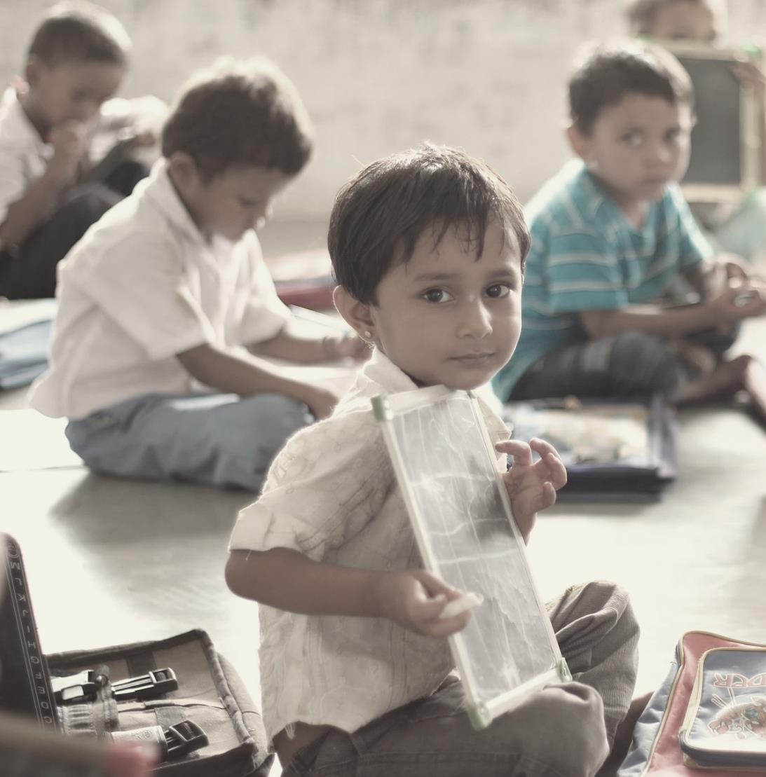
ROLE OF INDIAN COHORT
Education:
Conduct student workshops & activities
Organize public awareness programs & seminars
Include corporate officials and employees
Parishmita Gogoi, AUUP

Slide 12
ROLE OF INDIAN COHORT
Tour Operators And Travel Agents:
Responsibility to educate tourists not just about any destination but climate change too
Take initiatives to spread awareness
Parishmita Gogoi, AUUP

Slide 13
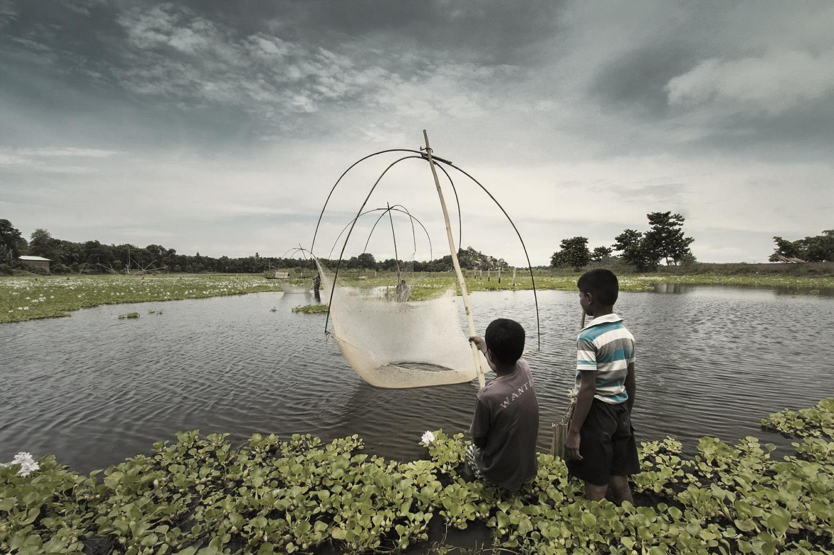
ROLE OF INDIAN COHORT
Sequential flow of information to the consumers
Parishmita Gogoi, AUUP

Slide 14
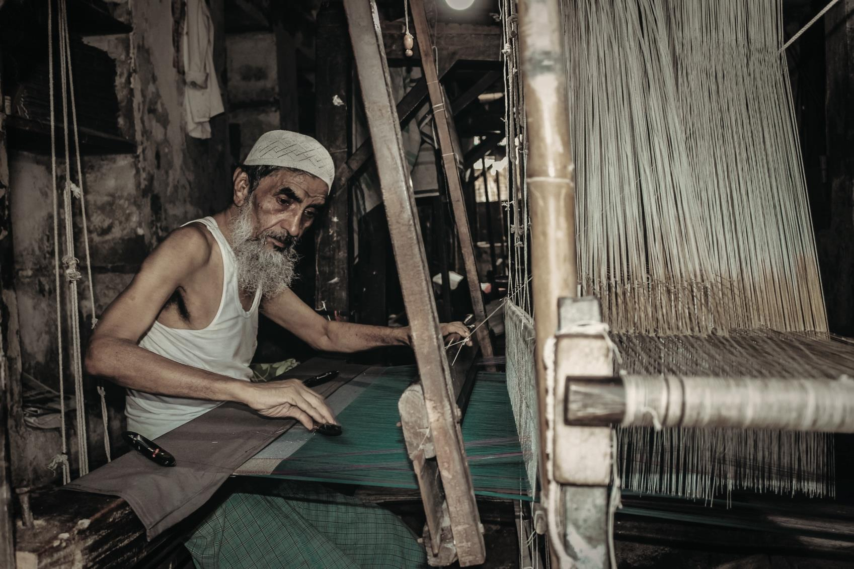
ROLE OF INDIAN COHORT
Community based tourism
Parishmita Gogoi, AUUP

Slide 15
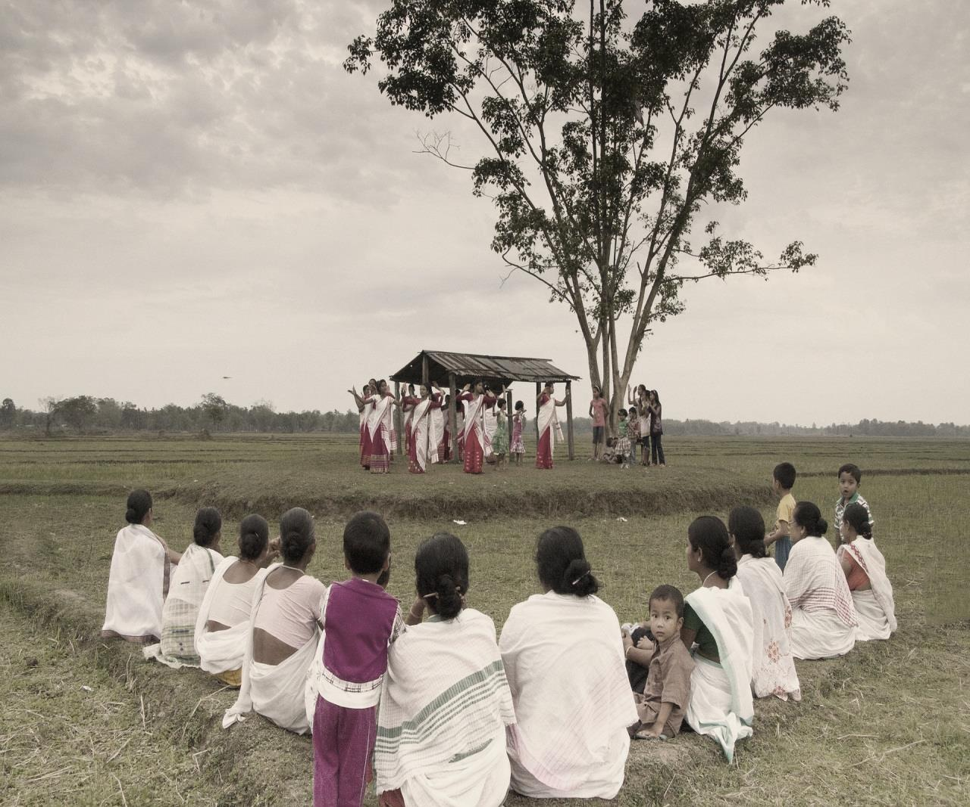
ROLE OF INDIAN COHORT
Choosing and promoting destinations wisely:
Spend more time at one place rather than going to 100 places
Do not travel just to post photos in social media
Parishmita Gogoi, AUUP

Slide 16
ROLE OF INDIAN COHORT
Think before posting on social media:
Geo-tag locations responsibly
Don’t decide on the basis of likes but how a place will benefit or suffer
Parishmita Gogoi, AUUP

Slide 17
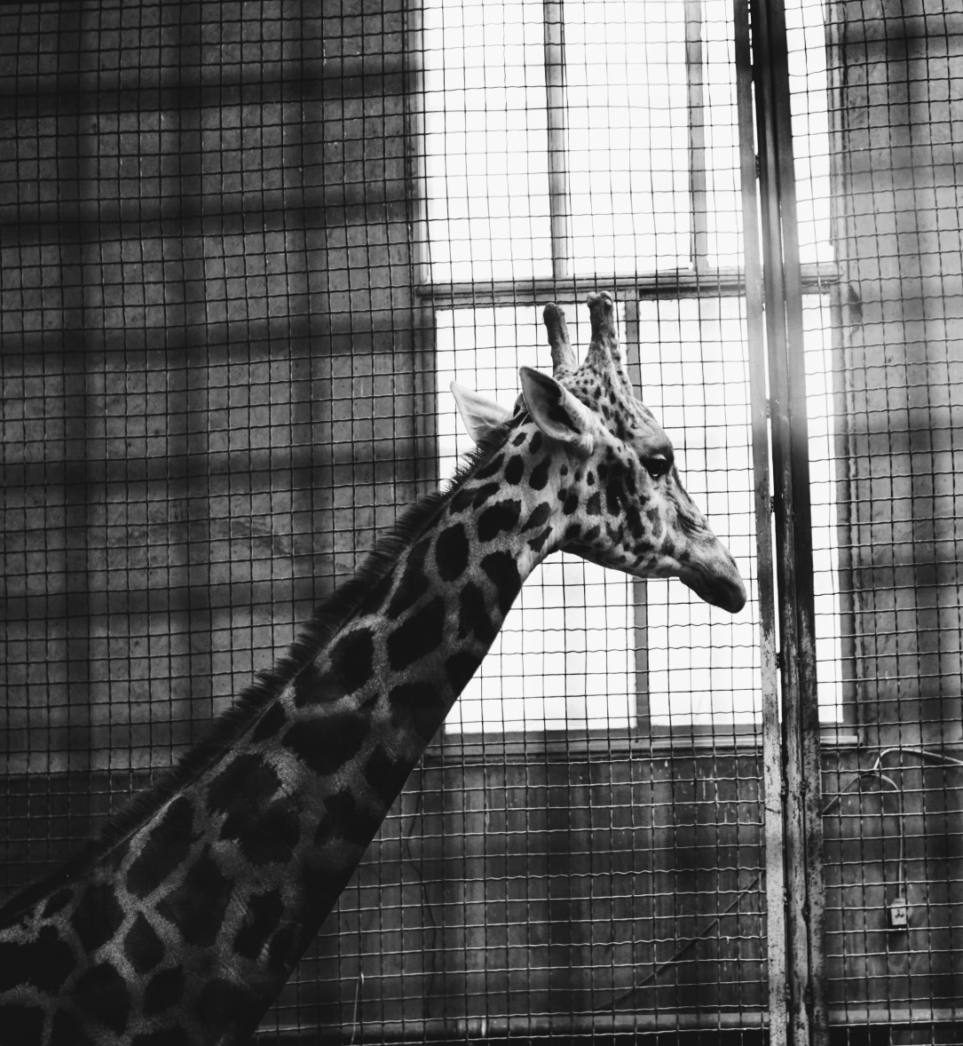
ROLE OF INDIAN COHORT
Promote national parks & wildlife sanctuary
Say no to Zoo
Ride animals responsibly
Go for real wildlife safari
Bird-watching
Parishmita Gogoi, AUUP

Slide 18
“The place to improve the world is first in one's own heart and head and hands, and then work outward from there.” ― Robert M. Pirsig
Parishmita Gogoi, AUUP

