Slide 1
THE BIG SHIFT. HOW DESTINATIONS MUST ADAPT TO COMPETE FOR THE TRAVELLER OF THE FUTURE
Greg Klassen
Partner, Twenty 31 Consulting

Slide 2
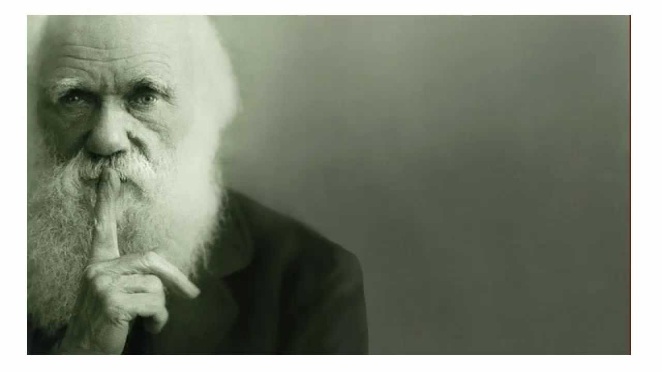
CHARLES DARWIN—
01 | Survival of the Fittest—1809
* | “It is not the strongest of the species that survives, nor the most intelligent, but the one most responsive to change”

Slide 3
NEW BUSINESS OF TOURISM VOCABULARY
01 | un tourism
02 | de-franchisation
03 | de-commoditization
* | and who will be tourism’s winners and losers of tomorrow?

Slide 4
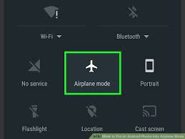
01 | Because most of us are in….

Slide 5
THE DMO MODEL
Tourism Partners / Destination Marketing Funds (DMF’s)
Tourism Industry
Visitors
Politics / Government
Citizen Advocates

Slide 6
THE DMO MODEL
Tourism Partners / Destination Marketing Funds (DMF’s)
Tourism Industry
Visitors
Politics / Government
Citizen Advocates
Customers/Visitors

Slide 7
THE DISRUPTOR MODEL
Customers/Visitors
Politics / Government
Citizen Advocates
Tourism Partners / DMFs
Tourism Industry

Slide 8
THE COMMUNITY BASED TOURISM MODEL
Customers/Visitors
Tourism Industry
Community
Government
Co-Creators of the Tourism Experience

Slide 9
FUTURE OF LEADERSHIP IN THE DIGITAL ECONOMY
01 | survey of more than 4,000 managers and executives from 120 countries and conducted interviews with dozens of C-level executives
02 | objective of understanding how a changing world is influencing what it means to be a great leader.
03 | Outcome from study suggests that respondents believe that leaders lack the mindset needed to bring about the strategic and cultural changes required to lead in the new economy.
Future of Leadership in the Digital Economy

Slide 10
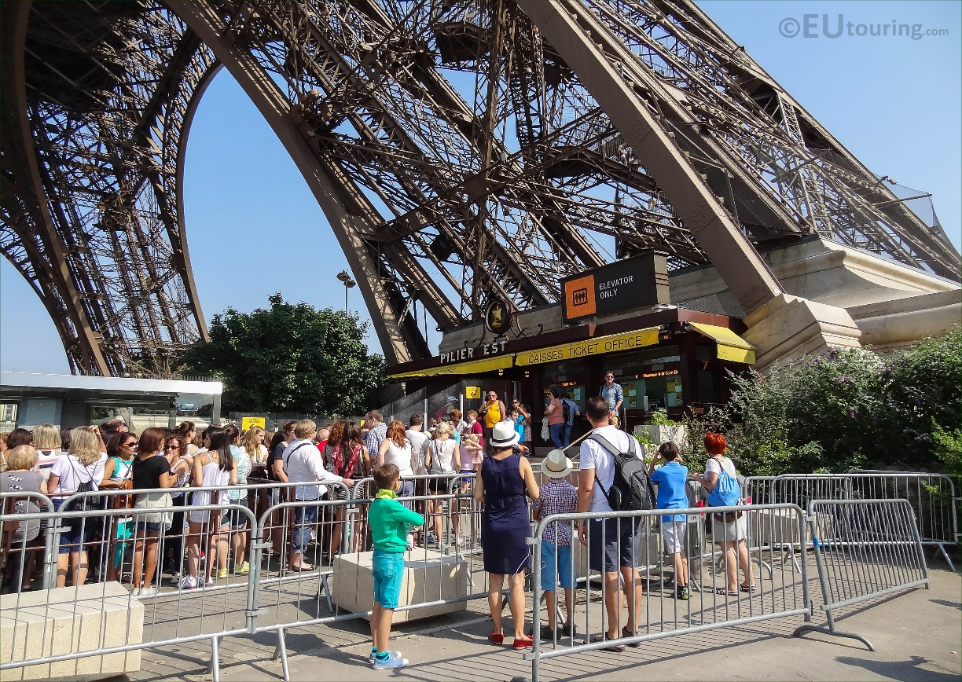
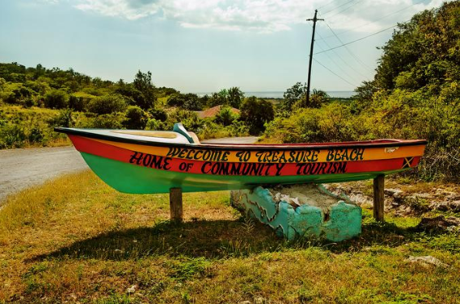
From mass + icons
DEFINITION OF TOURISM
Local + Authentic

Slide 11
WHAT ARE THE DRIVERS OF CHANGE?

Slide 12
DRIVERS OF CHANGE
1
2
3
Massive Growth
Consumer Behaviour
Technology

Slide 13
1. MASSIVE GROWTH
01 | International tourism with grow on average by 43 Million visitors per year.

Slide 14
WHAT IS FUELING THIS GROWTH?
01 | Low Cost Carriers
02 | De-regulation
03 | Growth of the world’s middle class
04 | Commoditization of travel
05 | Technology
06 | Investment
07 | China

Slide 15
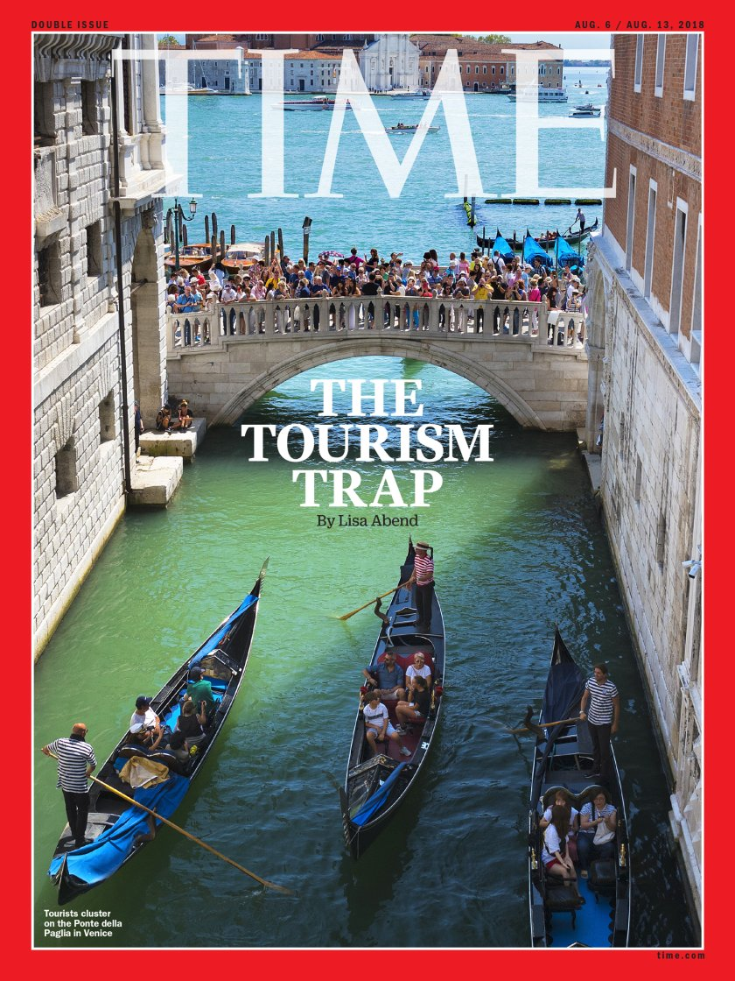
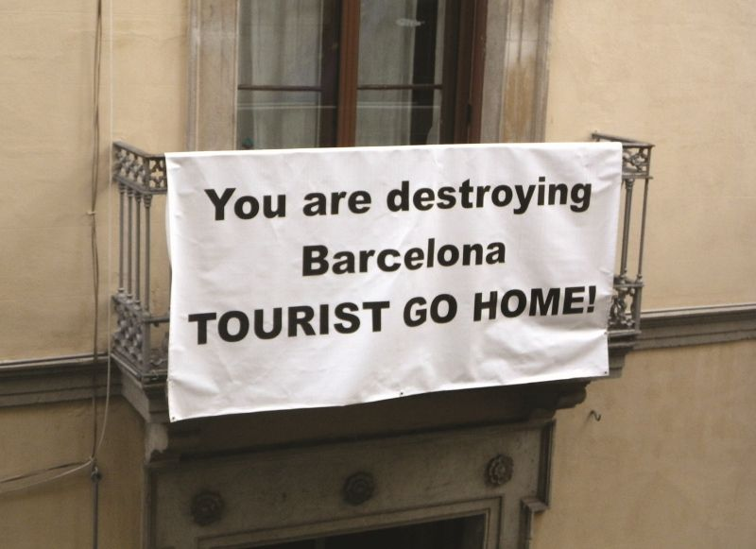
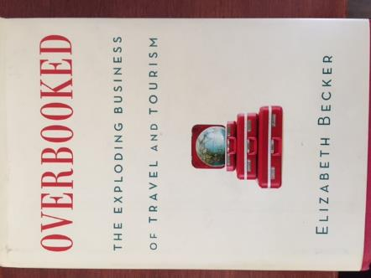
OUTCOMES OF GROWTH

Slide 16
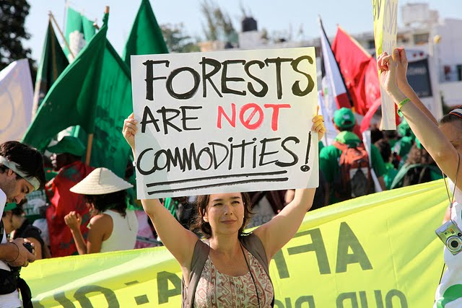
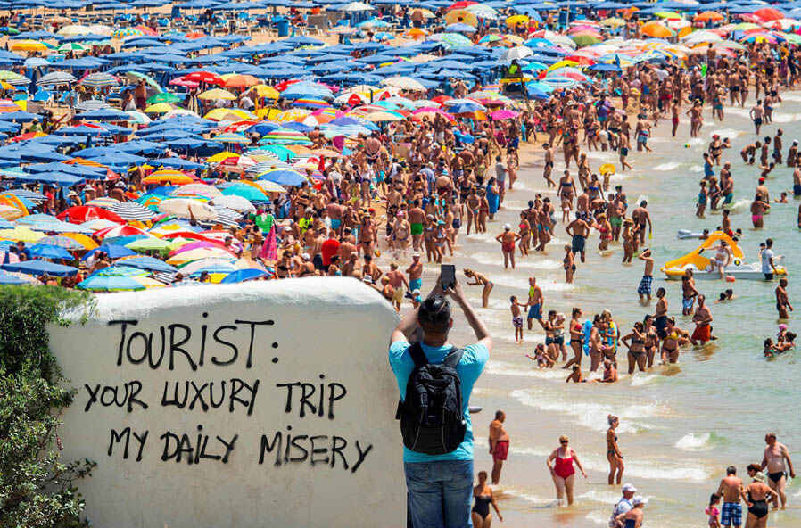
RESOURCE EXTRACTION
DIRTY TOURISM

Slide 17
2. CONSUMER BEHAVIOUR
01 | Millennial and Millennially-aligned travellers
02 | Not so much a demographic but an attitude towards the how and why of travel
03 | Increasingly attracted to brands that align with their values

Slide 18
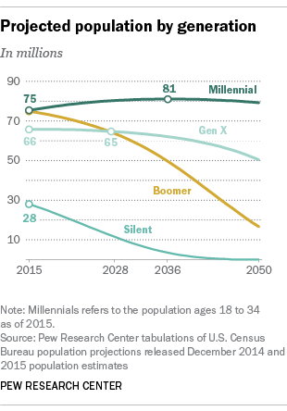
PROJECTED POPULATION BY GENERATION
North America

Slide 19
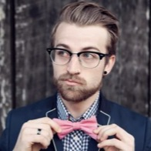
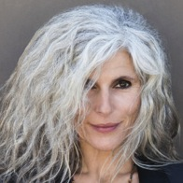
MILLENNIAL AND MILLENIALLY-ALIGNED TRAVELLERS
01 | Trend setters, niche interest markets; Index high on experiential, novelty, nature, culture and history

Slide 20
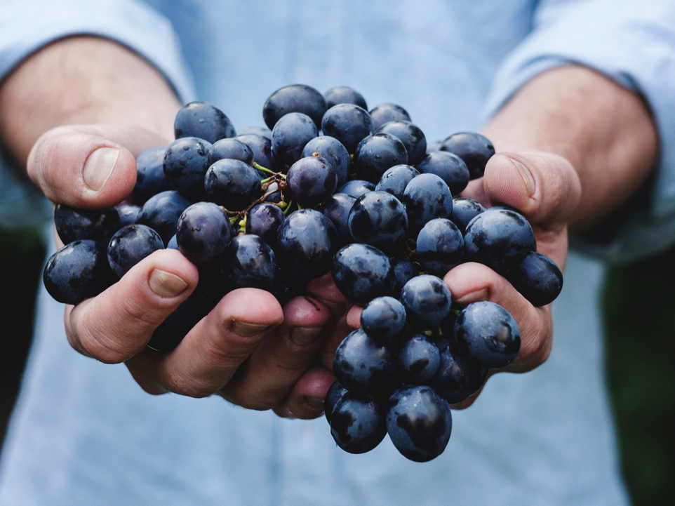
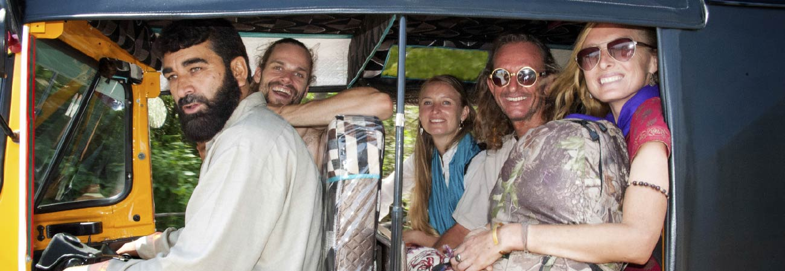
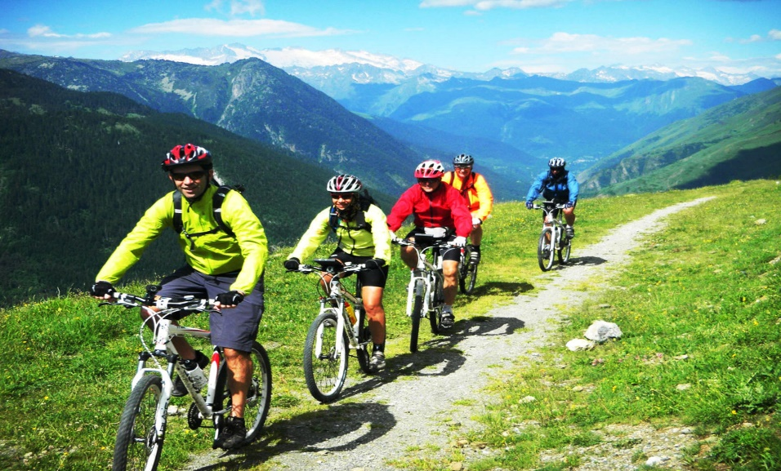
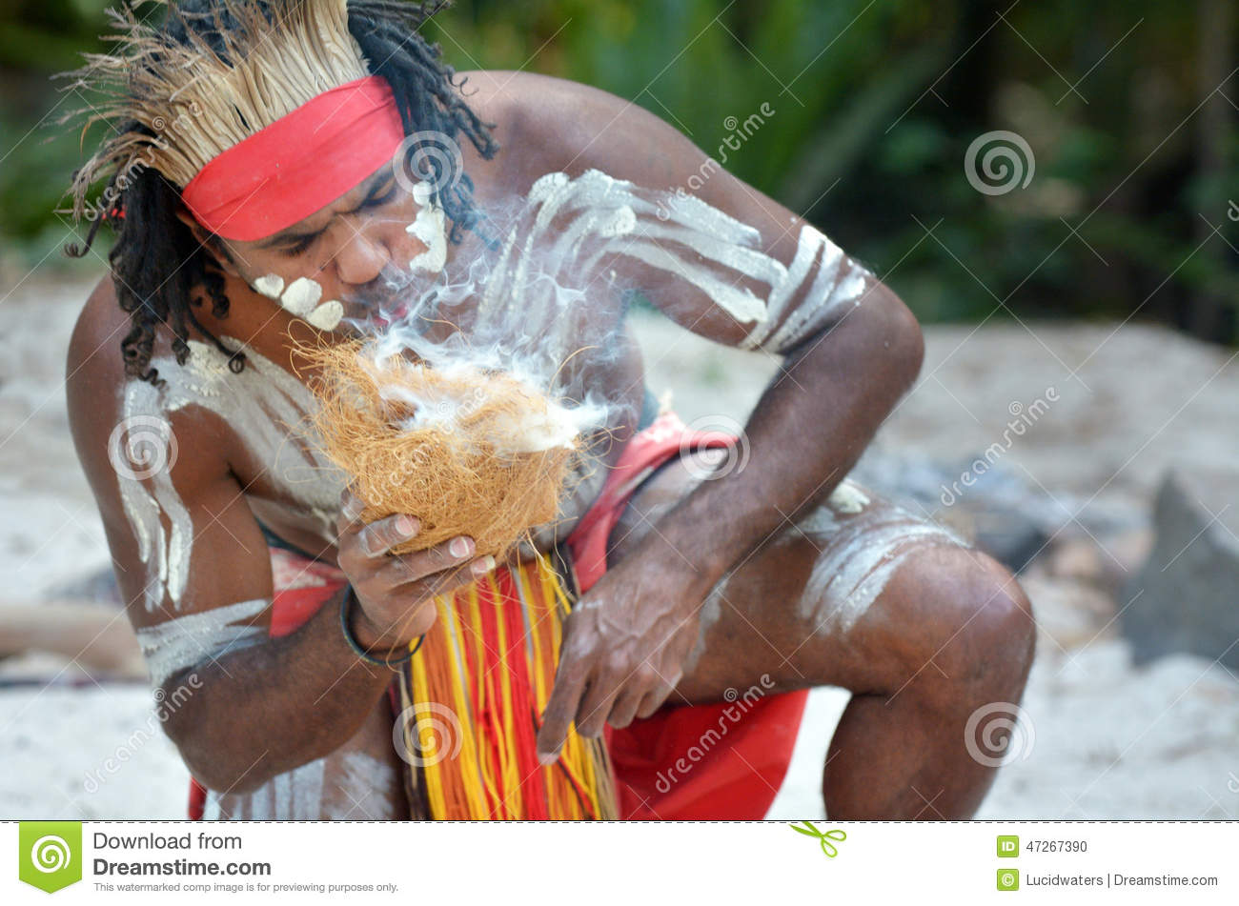
TRENDS IN TOURISM
Culinary and Agri-Food
Experiential Travel
Experiential
Adventure
Culture and Heritage

Slide 21
WOKE CAPITALISM
01 | 9 of 10 Gen Z, with $150B in global spending power believe that companies have a responsibility to social and environmental issues*
02 | in an era where governments fail to address the values of these consumers, business that aligns with their values can pick up the mantle and achieve competitive differentiation
*McKinsey

Slide 22
THE NEW (SUSTAINABLE) TRAVELLER
01 | UNWTO*
* | “The next century will mark the emergency of tourism destinations as a fashion accessory. The choice of holiday destination will help define the identity of the traveler and, in an increasingly homogeneous world, set them apart from the hordes of other tourists”

Slide 23
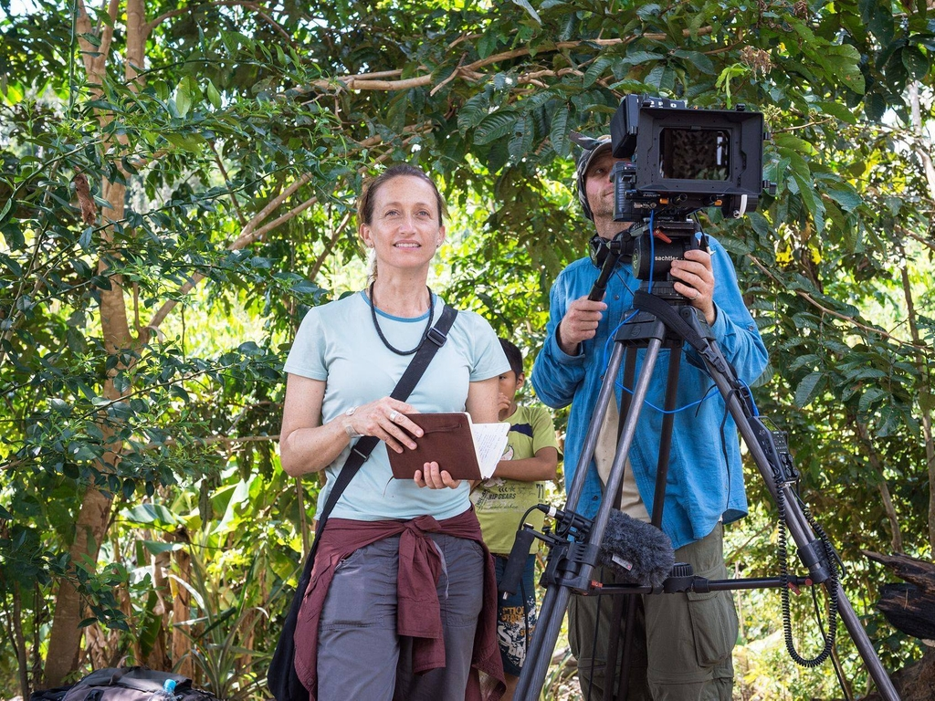
CELINE COUSTEAU— ATTA Near East
01 | Travelling is a privilege. Being a tourist is a true privilege. What are you going to do with that privilege?
* | “Today’s travellers move from simply seeking an experience to seeking a sense of purpose through tourism. A shared responsibility to protect the world and all its communities. Travel has the power to let us transcend the place we are in and think about other places”

Slide 24
THE NEW SUSTAINABLE TRAVELLER
Skift 2018 Trends Study
New Traveler Mindset
Authenticity and Trust
Travel for personal enrichment
Genuine travel brands that care about the customer AND the communities they impact
Fulfilling a Customer’s own quest
A return to our ordinary world feeling transformed and inspired
Adventure Travel and Tourism Association (ATTA)-2017
Motivations for Adventure Travel
Transformation
Expanded Worldview
Learning
Nature and Discovery
Support for Mental and Physical Health
Personal Connections
Meaningful Stories
Unique Experiences

Slide 25
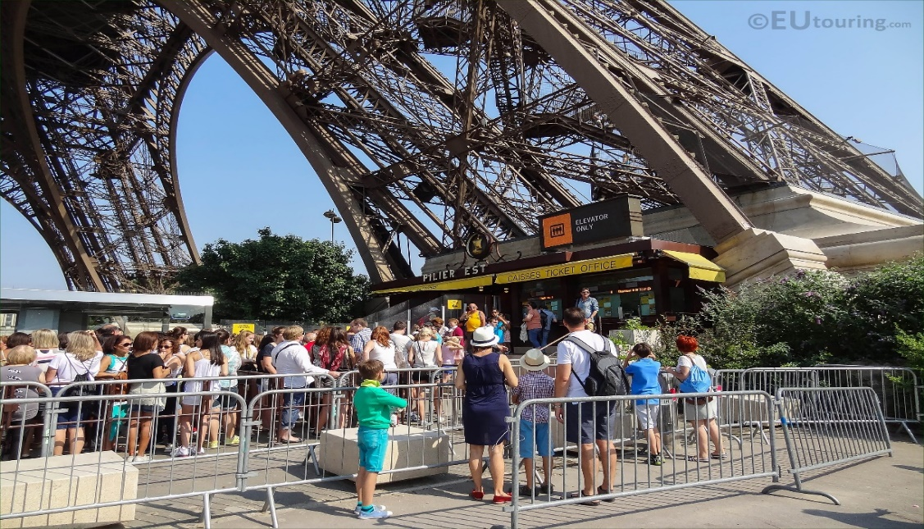
TARGET THE TRAVELLERS
AND THE TOURISTS WILL FOLLOW

Slide 26
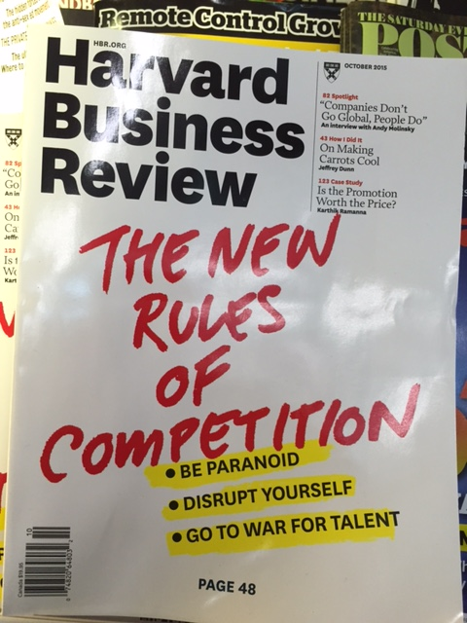
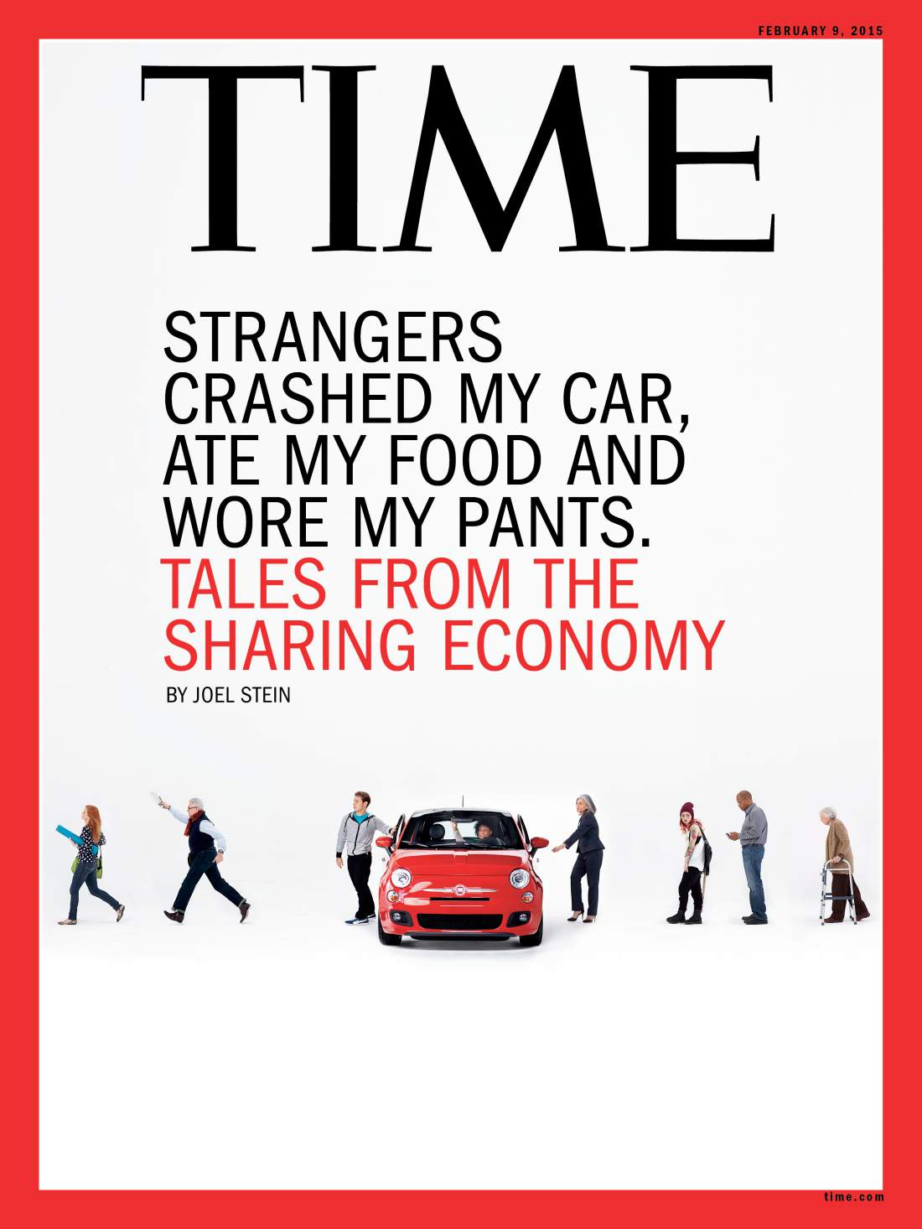
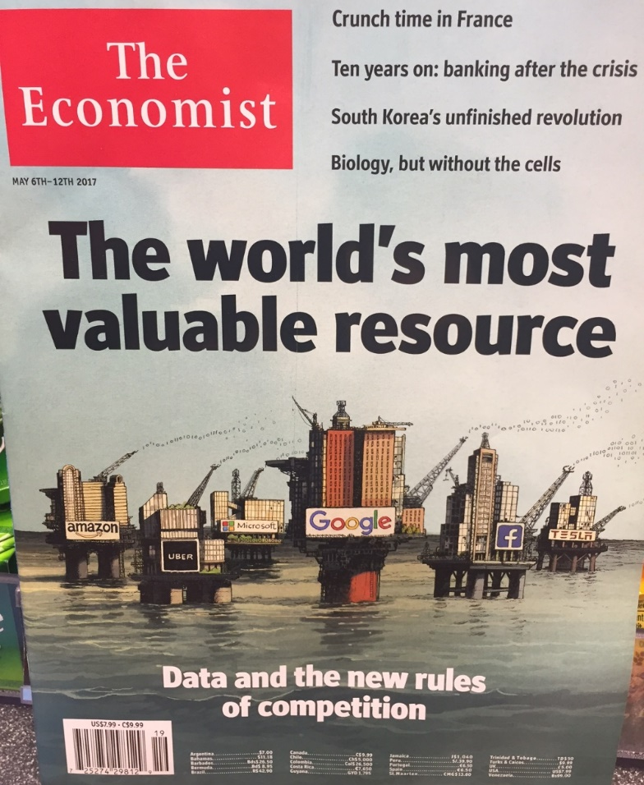
3. TECHNOLOGY

Slide 27
DISRUPTION
01 there are 10,000+ people in the Silicon Valley, Bangalore and Shanghai right now working to disrupt vulnerable industries*
* | Tourism is not exempt

Slide 28
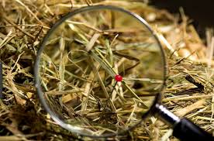
DISRUPTION- MARKETING

Slide 29
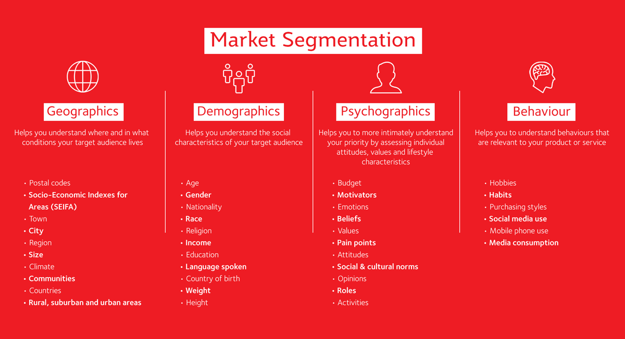
DISRUPTION- MARKET RESEARCH AND AUDIENCE SEGMENTATION

Slide 30
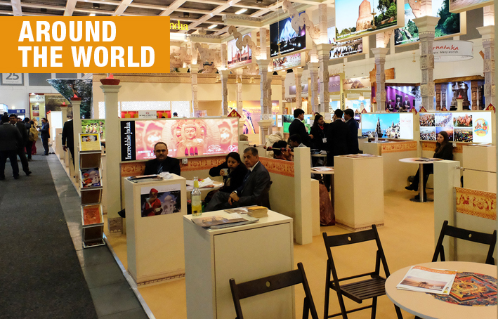
DISRUPTION- INTERNATIONAL TRADE SHOWS AND EVENTS

Slide 31
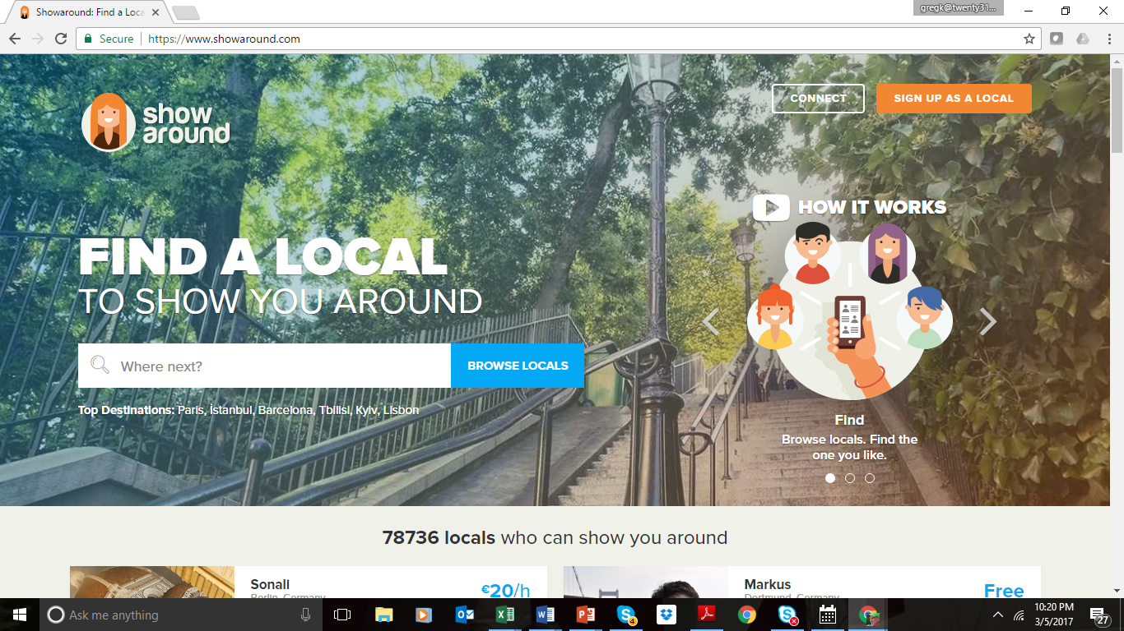
DISRUPTION- TOUR OPERATOR

Slide 32
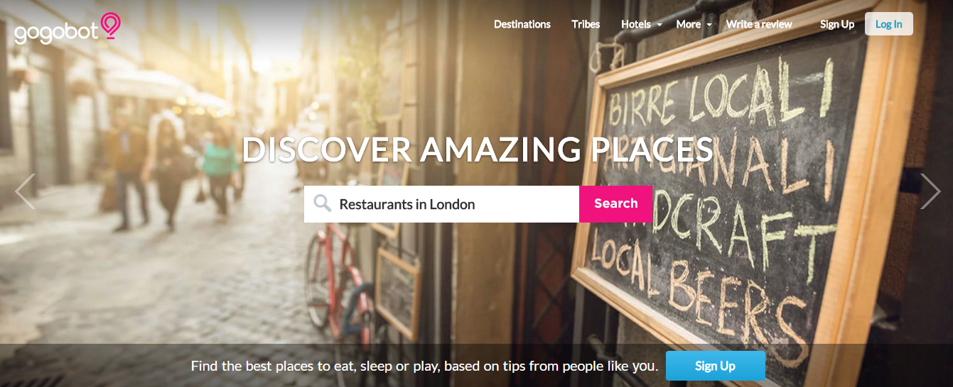
DISRUPTION-DMO

Slide 33
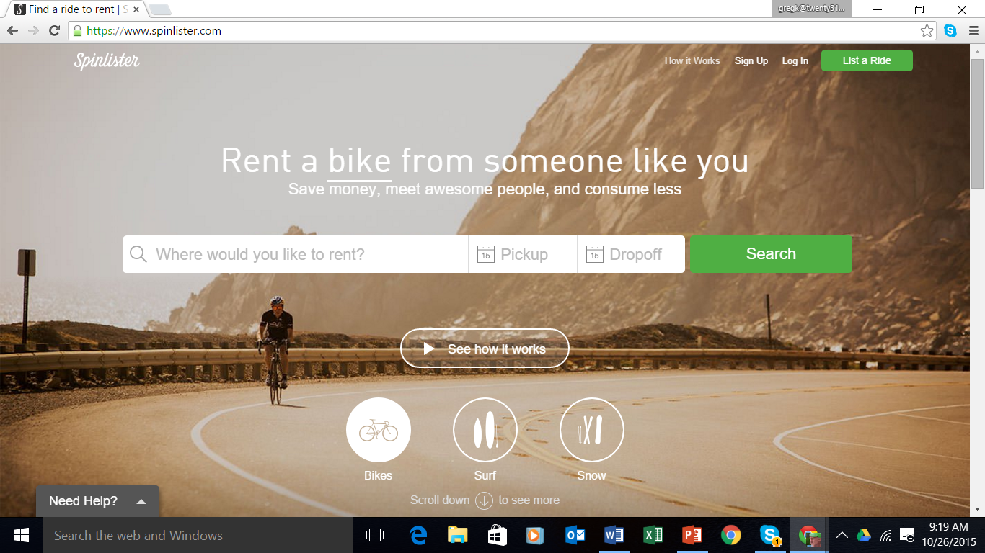
DISRUPTION-TRAVEL RENTALS

Slide 34
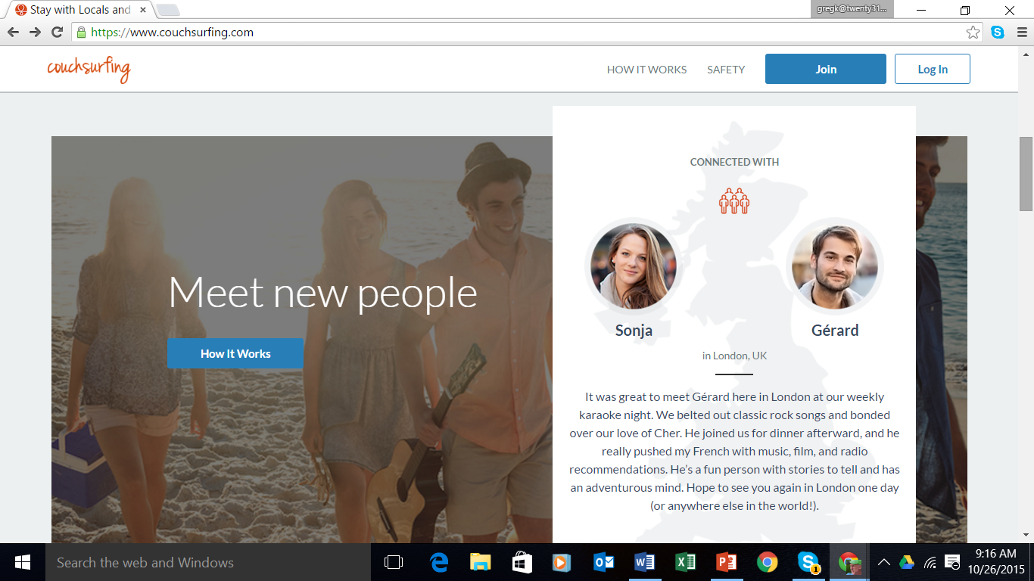
DISRUPTION-ACCOMMODATIONS

Slide 35
OPPORTUNITIES
01 For 2020 and beyond

Slide 36
OPPORTUNITIES
Be the Disrupter of the MASS
destination
01

Slide 37
SHIFT THE TOURISM MINDSET (from tourism consumption to contribution)
01 | and engage a new set of values-based, higher yield influential travelers for the future

Slide 38
SHIFT THE TOURISM MINDSET (from tourism consumption to contribution)
01 | develop a local and authentic experiential tourism destination and engage a new set of values-based, purpose-driven, higher yield, influential travelers to visit and share your home.

Slide 39
HOW?
| Develop a new social contract between the DMO and its stakeholders/community and then with the destination and the visitor…
Engage the visitor in our environment and in our culture so they share in its protection
(and hold each other to account)

Slide 40
HOW?
DESTINATION SOCIAL RESPONSIBILITY
TRAVELLER
SOCIAL RESPONSIBILITY

Slide 41
SUSTAINABLE FUTURES MINDSET
The New, Sustainable Tourism Economy
Co-create the tourism destination
Accounting for the true costs of tourism
Aware of economic, environmental and social impacts
Quality over quantity
Buys local when possible
Authenticity
Co-creates content
Social change
Preference to visit socially aware places
Prefers to work with socially aware operators
The Responsible Traveller
The Responsible Destination (DMO)
Sustainable Tourism Future Mindset
The Responsible Host Community
The Responsible Operator

Slide 42
WHAT IS DESTINATION SOCIAL RESPONSIBILITY (DSR)?
| The story of our destination. What is our core purpose?
Beyond selling more of our destination, what are our values, our mission, our vision for ourselves and then what would we like to share with our visitors?; Responsible DMO, community and partners;
The Responsible Traveller
The Responsible Destination (DMO)
Sustainable Tourism Future Mindset
The Responsible Host Community
The Responsible Operator
02 | And then; What is our core message?;

Slide 43
NEW TOURISM MATH: TOTAL TOURISM REVENUE
x
x
x
=
VOLUME
SPEND/DAY
TOTAL DAYS
NUMBER OF DISCRETE VISITS
TOTAL REVENUE
The new DMO mindset

Slide 44
WHAT IS TRAVELLER SOCIAL RESPONSIBILITY (TSR)?
01 | the obligations we ask of our visitors. To respect our culture, environment and lifestyle. It’s whom we target as visitors. Ensuring we target prospective travellers that align our values as a community and as a tourism destination.
The Responsible Traveller
The Responsible Destination (DMO)
Sustainable Tourism Future Mindset
The Responsible Host Community
The Responsible Operator
02 | And then; to develop our core strategy and brand to reach these travellers;

Slide 45
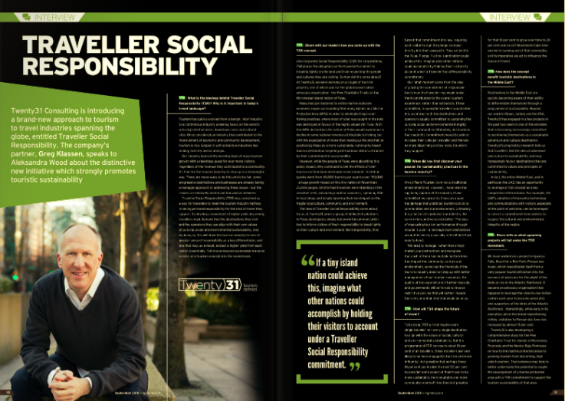
TRAVELLER SOCIAL RESPONSIBILITY (TSR)
Thought Leadership in The National
Introducing a new level of accountability for our visitors

Slide 46
CHALLENGES IN SUSTAINABLE TOURISM COMPETITIVENESS
1
2
3
Overtourism + Compression
Awareness of “Next 20” and Seasonality
Over-reliance on mass segments

Slide 47
OPPORTUNITIES FOR SUSTAINABLE TOURISM COMPETITIVENESS
1
Cost and Compression in top iconic destinations, sites and attractions to local communities
Crowding & Compression
Seasonal and Local Dispersion

Slide 48
OPPORTUNITIES FOR SUSTAINABLE TOURISM COMPETITIVENESS
2
Review key strengths as a destination and brand and market destination as “local and authentic” alternative to mass destinations. Brand and market these next destinations/experiences
Brand niche markets and experiences
Local and Authentic; niche alternatives

Slide 49
OPPORTUNITIES FOR SUSTAINABLE TOURISM COMPETITIVENESS
3
Transition reliance on mass to local markets and market segments. Invest in next gen marketing, travel trade and other key communications channels
Over-Reliance on mass markets/segments
Transition to next gen markets , segments and channels

Slide 50
TO CONCLUDE

Slide 51
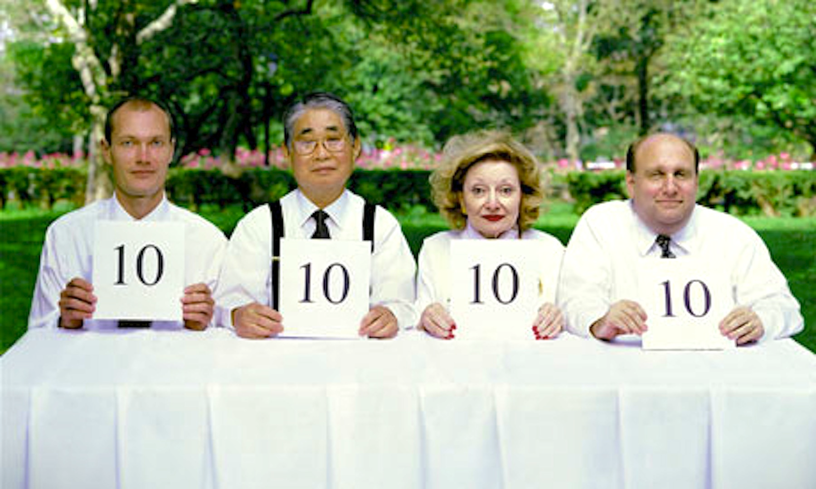
YESTERDAY’S DESTINATION SCORECARD
More
更多
lisää
plus

Slide 52
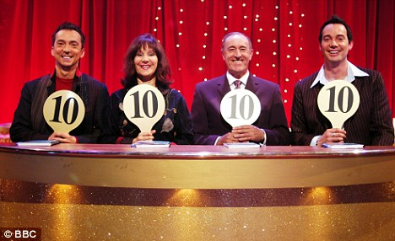
TOMORROW’S DESTINATION SCORECARD
Dispersion
Higher Yield
Community Development /Job Creation
Total Revenue

