Slide 1

P
PROJEKT DRAGON – THE CHINA OPPORTUNITY

Slide 2


INDIA RIDING THE THIRD WAVE OF
CHINESE OUTBOUND TOURISM
Prof. Dr. Wolfgang Georg Arlt FRGS FRAS – CEO COTRI 6th December 2019

Slide 3
INDIA RIDING THE THIRD WAVE OF
CHINESE OUTBOUND TOURISM
Content
Introduction COTRI
Chinese Outbound Tourism – The First and Second Wave
Chinese Outbound Tourism to India today
India Riding the Third Wave
COTRI China Outbound Tourism Research Institute | china-outbound.com | +49 40 558 99 576
COTRI China Outbound Tourism Research Institute | china-outbound.com | +49 40 558 99 576

Slide 4






CHINA OUTBOUND TOURISM RESEARCH INSTITUTE
Knowledge Partner
COTRI China Outbound Tourism Research Institute | china-outbound.com | +49 40 558 99 576

Slide 5
COTRI China Outbound Tourism Research Institute is the world’s leading independent research institute for consulting, research, information, training, and quality assessment relating to the Chinese outbound tourism market.
COTRI is a privately organised, independent institute registered in Germany. In addition to the head office in Hamburg, Germany, COTRI has a Chinese office based in Beijing.
COTRI was established in 2004 by its founder and CEO Prof. Dr. Wolfgang Georg Arlt FRGS FRAS, a sinologist and professor in international tourism management with more than 40 years of practical and academic experience in Chinese tourism.
COTRI’s main goal is to enable private companies and public institutions all over the world to offer successfully high-quality travel, tourism, and leisure services for Chinese visitors according to their specific expectations and demands. To reach this goal, COTRI offers a broad range of customised services including consulting, market research, strategy development quantitative analysis and data, training and other services for a range of companies, public organisations and destinations.
To support its customers in the Chinese market, COTRI uses its vast databases, extensive scientific, cultural, and industry knowledge and experience as well as the close contacts and partnerships with most leading public and private sector tourism organisations in China and all over the world.
COTRI China Outbound Tourism Research Institute | china-outbound.com | +49 40 558 99 576

Slide 6

Prof. Dr. Wolfgang Georg Arlt FRGS FRAS
First visit to the People’s Republic of China in 1978
1991-1999, owner of Inbound Tour Operator China-Europe with offices in Beijing and Berlin
COTRI founder and CEO since 2004
Professor for International Tourism Management at West Coast University of Applied Sciences Germany (Heide)
Visiting researcher/ professor at universities in China, United Kingdom, Australia and New Zealand
Member of PhD Supervisor/Examiner team at universities in Hong Kong, Germany, UK and Spain
Research Fellow of the Japanese Society for the Promotion of Science (Tokyo)
Member of the United Nations World Tourism Organisation (UNWTO) Expert Panel (Madrid)
Vice President Western Europe ITSA International Tourism Studies Association (Beijing/Greenwich)
Vice President for China TCWTA Twin Cities World Tourism Association (Zurich)
Fellow of the Royal Geographical Society (FRGS) London
Fellow of the Royal Asiatic Society (FRAS) London
Fellow of International Association of China Tourism Studies (Guangzhou)
Board member and member of Human Capacity Development Committee PATA Pacific Asia Travel Association (Bangkok)
Member of Expert Committee of WTCF (Beijing)
COTRI China Outbound Tourism Research Institute | china-outbound.com | +49 40 558 99 576

Slide 7



CTT
CHINA TOURISM TRAINING
COTRI and the globally top-ranked Hong Kong Polytechnic University, School of Hotel and Tourism Management (SHTM) have brought their expertise together to provide the comprehensive CTT China Tourism Training online programme which offers five executive- level specialisations for a range of key industry branches. These consist of Hospitality, Destinations, Retail, Attractions and Transportation. The trainings are flexible, self-paced and contain numerous professional Best Practice Examples and up-to-date information, ensuring that learning is practically-focused, interactive and engaging. Additional benefits of the CTT China Tourism Training programme include the following:
Discussion forums empowering participants to address questions, exchange ideas and stay connected with peers.
Addresses all major questions and topics relevent to specific industry sectors.
Industry insight of Best Pracitice Examples utilising videos, interviews, websites and other relevent materials provided by 50 leading global tourism providers.
Membership into the CTT Alumni network and SHTM Alumni Network
COTRI China Outbound Tourism Research Institute | china-outbound.com | +49 40 558 99 576

Slide 8

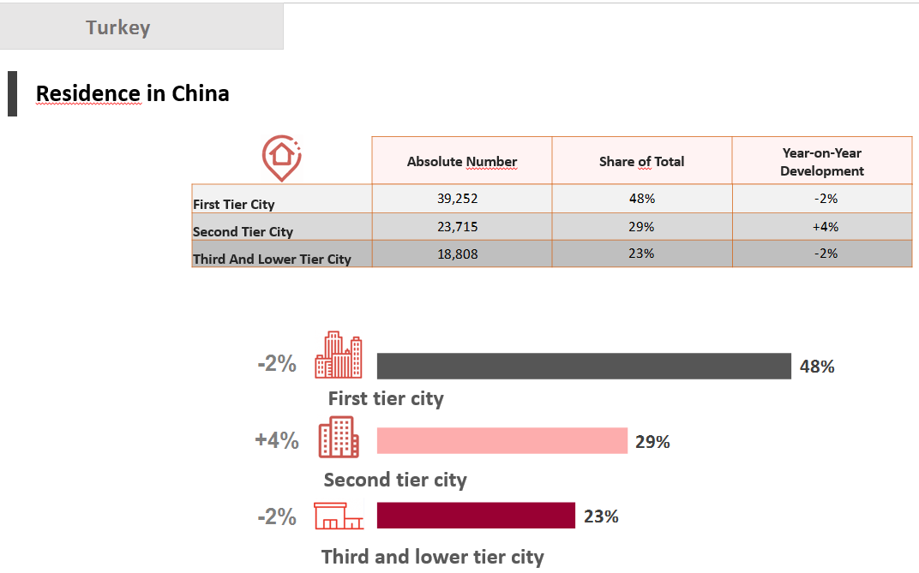
COTRI ANALYTICS
COTRI ANALYTICS provides the most reliable data and analysis for 80 key Chinese outbound tourism destinations every quarter of the year. Bloomberg L.P. relies on COTRI ANALYTICS since 2015.
For each destination a complete quarterly dataset is offered including:
Arrival numbers
Age structure
Gender structure
Education levels
Residence in China
Purpose of visit
Organisation of travel
Type of accommodation used
Data is provided as a comprehensive excel data sheet plus eight power point slides per destination, which includes an executive-level analysis of the development in that quarter and infographics for each data category.
COTRI China Outbound Tourism Research Institute | china-outbound.com | +49 40 558 99 576

Slide 9
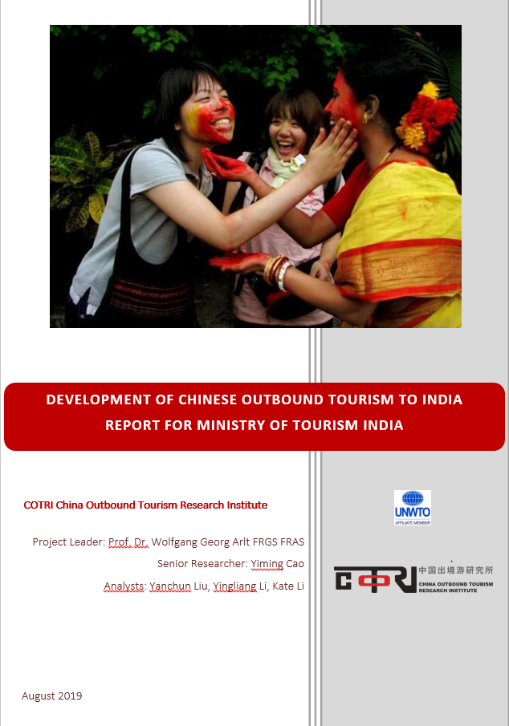
CUSTOMISED RESEARCH
AND CONSULTING OFFERS
A COTRI customised offer is a tailored project designed specifically for the needs of your organisation or company. Regardless of the nature of your goals, COTRI puts your business in focus and provides solutions to your unique situation. This research-based service includes components such as:
Market Research: General trends in the Chinese tourism market, competitor analysis and forecasts;
Netnography, focus groups and expert interviews;
Market strategy development and product adaptation;
Identification of potential distribution partners and support in organising meetings.
COTRI China Outbound Tourism Research Institute | china-outbound.com | +49 40 558 99 576

Slide 10
INDIA RIDING THE THIRD WAVE OF
CHINESE OUTBOUND TOURISM
Content
Introduction COTRI
Chinese Outbound Tourism – The First and Second Wave
Chinese Outbound Tourism to India today
India Riding the Third Wave
COTRI China Outbound Tourism Research Institute | china-outbound.com | +49 40 558 99 576
COTRI China Outbound Tourism Research Institute | china-outbound.com | +49 40 558 99 576

Slide 11

China’s GDP Per Capita 2010-2018 (in USD)
In 2018, China’s GDP per capita reached USD 9,789, up by 6.1% from 2017.
In 2019, China’s GDP per capita will break through the USD 10,000 barrier.
Source: National Bureau of Statistics of China (2019)
www.china-outbound.com
2019

Slide 12
Wealth Distribution in China 2018
Class | Spending amount per day | Percentage of population | In total number
High | More than 50 USD | 0.8% | 12 mio.
Upper-middle | 20-50 USD | 9.7% | 135 mio.
Lower-middle | 10-20 USD | 29.0% | 401 mio.
Low | 2-10 USD | 59.6% | 834 mio.
Poor | Less than 2 USD | 0.9% | 13 mio.
The wealth distribution defined by dollar-per-day spending amounts expressed in purchasing power parity terms is shown in the table.
The upper-middle class (annual spending power 7,300-18,250 USD per year) and the upper class (above 18,250 USD) are affluent enough to consider outbound leisure tourism paid by themselves.
www.china-outbound.com
2019

Slide 13
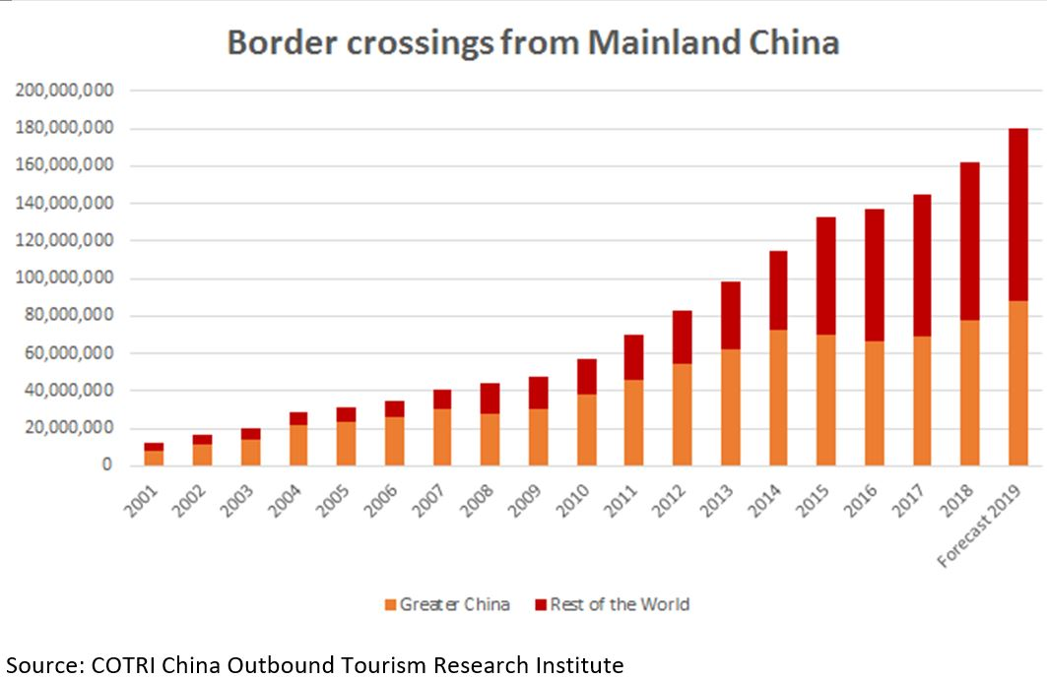
China’s Outbound Tourism 2001-2019

Slide 14
Total Number of outbound trips of Chinese citizens 1949-2018 (Source: COTRI)

Slide 15
China’s Outbound Tourism 2019-2030 (COTRI Forecast)

Slide 16
Source: COTRI ANALYTICS
UNWTO Tourism Highlights 2011-2018
2018 Spending per trip USD 1,700
www.china-outbound.com

Slide 17
Top 15 Most Preferred Destinations 2010-2018
 | 2011 | 2012 | 2013 | 2014 | 2015 | 2016 | 2017 | 2018
1 | Hong Kong | Hong Kong | Hong Kong | Hong Kong | Hong Kong | Hong Kong | Hong Kong | Hong Kong
2 | Macau | Macau | Macau | Macau | Macau | Macau | Macau | Macau
3 | South Korea | South Korea | Thailand | South Korea | Thailand | Thailand | Thailand | Thailand
4 | Taiwan | Thailand | South Korea | Thailand | South Korea | South Korea | Japan | Japan
5 | Thailand | Taiwan | Taiwan | Taiwan | Japan | Japan | South Korea | Vietnam
6 | Singapore | Singapore | Singapore | Japan | Taiwan | Taiwan | Vietnam | South Korea
7 | Vietnam | Malaysia | Vietnam | USA | USA | USA | USA | Singapore
8 | Malaysia | USA | USA | Vietnam | France | Singapore | Singapore | USA
9 | France | Japan | Malaysia | France | Italy | Vietnam | Italy | Malaysia
10 | USA | Vietnam | France | Singapore | Singapore | Malaysia | Taiwan | Taiwan
11 | Japan | France | Japan | Malaysia | Vietnam | Italy | Malaysia | Italy
12 | Italy | Italy | Italy | Italy | Malaysia | France | France | France
13 | Germany | Russia | Russia | Russia | Germany | Indonesia | Indonesia | Indonesia
14 | Indonesia | Germany | Germany | Germany | Indonesia | Germany | Germany | Cambodia
15 | Australia | Indonesia | Indonesia | Indonesia | Switzerland | Russia | Russia | Russia
www.china-outbound.com

Slide 18
China’s Outbound Tourism entering the Third Wave
1997-2014 2015-2019 2020->
First Wave
Start of Approved Destination Status system, visa necessary
Growth from less than 10 million border crossings to more than 100 million
Limited information available
Limited connectivity
Mostly package tour group travel
Main sights in main destinations
Sightseeing and shopping
Outbound travel exceptional activity
www.china-outbound.com

Slide 19
China’s Outbound Tourism entering the Third Wave
1997-2014 2015-2019 2020->
First Wave
Start of Approved Destination Status system, visa necessary
Growth from less than 10 million border crossings to more than 100 million
Limited information available
Limited connectivity
Mostly package tour group travel
Main sights in main destinations
Sightseeing and shopping
Outbound travel exceptional activity
Second Wave
ADS disappears, start of multiple visa / eVisa / visa-free travel
Growth from 100 million border crossings to almost 200 million
Plenty of information, diminished language problem
Strong growth of connectivity
1st tier inhabitants & millennials mostly FIT / customised trips
Visiting new destinations
Special interest / themed tours
Outbound travel part of lifestyle
www.china-outbound.com

Slide 20
China’s Outbound Tourism entering the Third Wave
1997-2014 2015-2019 2020->
First Wave
Start of Approved Destination Status system, visa necessary
Growth from less than 10 million border crossings to more than 100 million
Limited information available
Limited connectivity
Mostly package tour group travel
Main sights in main destinations
Sightseeing and shopping
Outbound travel exceptional activity
Second Wave
ADS disappears, start of multiple visa / eVisa / visa-free travel
Growth from 100 million border crossings to almost 200 million
Plenty of information, diminished language problem
Strong growth of connectivity
1st tier inhabitants & millennials mostly FIT / customised trips
Visiting new destinations
Special interest / themed tours
Outbound travel part of lifestyle
Third Wave
Easy / no visa becomes norm
Growth from 200 million border crossings to 400 million in a decade
Most travellers savvy about international tourism, language problem disappearing
Further growth of connectivity
FIT/customised trips become norm
New destinations following KOLs
“Live like a local” / Special interest
Outbound travel normal part of life
www.china-outbound.com

Slide 21
INDIA RIDING THE THIRD WAVE OF
CHINESE OUTBOUND TOURISM
Content
Introduction COTRI
Chinese Outbound Tourism – The First and Second Wave
Chinese Outbound Tourism to India today
India Riding the Third Wave
COTRI China Outbound Tourism Research Institute | china-outbound.com | +49 40 558 99 576
COTRI China Outbound Tourism Research Institute | china-outbound.com | +49 40 558 99 576

Slide 22
Chinese Arrivals to India 2011-2018
Chinese Arrival to India 2011-2018
Slow increase from about 140,000 to 180,000 between 2011 and 2014.
Total annual arrivals from China to India breaking through the 200,000 barriers in 2015 for the first time.
A decline of 5.5% from 2016 to 2017 because of border dispute.
Chinese arrivals bouncing back to a historical high at 282,195 in 2018 (+13%).
During first nine months of 2019 233,000 arrivals, plus 18%.
282,195
181,020
142,218
Source: COTRI Analytics
www.china-outbound.com
2019

Slide 23
Chinese Arrivals to India 2011-2018 Market Share
India’s Market share of Chinese Outbound Tourism 2015-2018
India has a share of less than 0.2% of the whole China outbound tourism market and of less than 0.4% of the Chinese outbound tourism market going beyond Greater China (Hong Kong, Macau, Taiwan).
Source: COTRI Analytics
www.china-outbound.com
2019

Slide 24
Chinese Arrivals to India 2011-2018 Market Share
Market share of Chinese Travellers for Total Indian Incoming Market 2015-H1 2019
In 2001, Travellers from China accounted for 0.5% of India’s international tourism arrivals.
The share of Chinese travellers increased to 2.6% in 2015 and stayed below 3% until 2018.
The market share of Chinese arrivals among total Indian arrivals reached a historical high at 3.0% in the first half of 2019.
Source: India Ministry of Tourism Board
www.china-outbound.com
2019

Slide 25
Characteristics of Chinese Travellers to India
India | Absolute Number | Share of Total
Arrivals
Total Arrivals From China, All Destinations (4th quarter 2018) | 40,000,000
Total Arrivals From China, India (4th quarter 2018) | 84,487 | 0.2%
Age
0-29 | 13,518 | 16%
30-49 | 57,451 | 68%
50+ | 13,518 | 16%
Gender
Male | 54,917 | 65%
Female | 29,571 | 35%
Education Level
Up To High School | 18,587 | 22%
Up To College | 25,346 | 30%
Above College | 40,554 | 48%
Residence in China
First Tier City | 52,382 | 62%
Second Tier City | 23,656 | 28%
Third And Lower Tier City | 8,449 | 10%
Purpose of Visit
Corporate | 38,019 | 45%
MICE | 8,449 | 10%
Leisure | 21,122 | 25%
VFR | 4,224 | 5%
Other | 12,673 | 15%
Organisation of Travel
Non-Package Tour Traveller | 50,692 | 60%
Package Tour Traveller | 33,795 | 40%
Type of Accommodation
Accomodation Up To 2 Star | 12,673 | 15%
Accomodation 3 Star | 15,208 | 18%
Accomodation 4-5 Star | 56,607 | 67%
Majority Middle-aged Visitors
Majority Higher Educated Visitors
Majority Non-Package Tour Visitors
Source: COTRI Analytics
Source: COTRI Analytics
www.china-outbound.com
2019

Slide 26
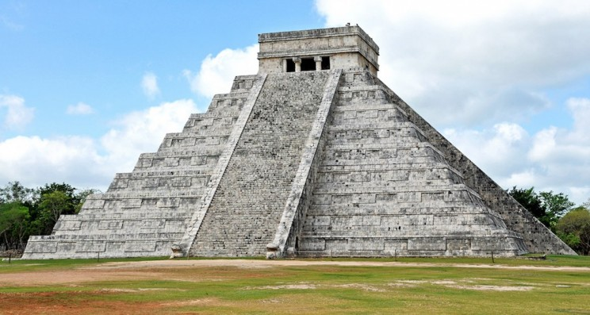

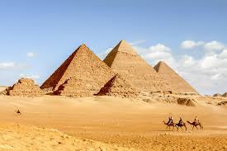
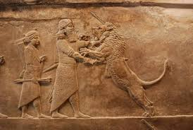
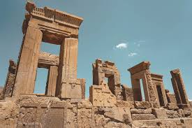
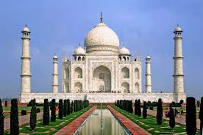
India among the cultures from BCE accepted as equal in China
Maya Roman Empire Egypt Mesopotamia Persia
No Heir Heritage sites visited Pyramids visited Not a good idea to More Chinese visitors
Italy small country Egypt not so powerful visit Iraq and Syria but unknown
India
Only other continuing
great civilization
www.china-outbound.com
2019

Slide 27
Arguments for Chinese to Travel to India
Friendly Visa policy
English Language widely spoken
History of long-term good relationship
Influence from Bollywood movies
Pilgrimage tours
37 UNESCO sites
Quality medical and healthcare services with affordable prices
Cheap - if limited - flight connections
Middle-distance destination, close enough for shorter trip during Golden Weeks
Hurdles:
Anxiety about religious issues
Lack of Information
Image of dangerous place to visit (Assaults on women, sanitation, hygience, pollution)
www.china-outbound.com
2019

Slide 28
Current Interest in India by Chinese Market Segments
Market Segment | Interest | Services Expected
Families (with kids) | Sightseeing; beach, national parks, wildlife, museums, local food; shopping | Four-star and five-star hotels; package ticket for family; Mandarin-speaking services
Couples | Wedding; honeymoon; shopping; experiencing daily Indian life (festivals, food and clothes etc.) | Wedding/honeymoon services, photography, four-star and five-star hotels; thematic hotels; local tour guides; courses experiencing local life (e.g. cooking Indian food; making Indian handcraft, learning dancing etc.);
Friends | Relaxation; cultural activities; festivals; outdoor activities | Thematic hotel or B&B (bed and breakfast) with Indian characteristics; courses experiencing local life (e.g. cooking Indian food; making Indian handcraft, learning dancing etc.);
Individuals | Relaxation; culture activities; outdoor activities | Four-star and five-star hotels; Thematic hotel or B&B (bed and breakfast) with Indian characteristics; local tour guides; courses experiencing local life (e.g. cooking Indian food; making Indian handcraft, learning dancing etc.)
www.china-outbound.com
2019

Slide 29
INDIA RIDING THE THIRD WAVE OF
CHINESE OUTBOUND TOURISM
Content
Introduction COTRI
Chinese Outbound Tourism – The First and Second Wave
Chinese Outbound Tourism to India today
India Riding the Third Wave
COTRI China Outbound Tourism Research Institute | china-outbound.com | +49 40 558 99 576
COTRI China Outbound Tourism Research Institute | china-outbound.com | +49 40 558 99 576

Slide 30

India Riding the Third Wave
FOR CHINESE!
Using the THIRD WAVE of Chinese outbound tourism, with strong government support and successful public-private cooperation, India can move from about 350,000 arrivals in 2019 to more than 2.6 million arrivals by 2024.
www.china-outbound.com
2019

Slide 31

Positive example Cambodia
Based on product adaptation and investment into tourism infrastructure, Cambodia achieved between 2014 and 2019 a remarkable growth of arrivals from China within a short period of time.
www.china-outbound.com
2019

Slide 32

Negative example Sri Lanka
After a strong growth fuelled by low price mass market groups, the development stagnated and went into decline already in H2 of 2018, accelerating after the Easter Bombing 2019 and the stop of the offer of eVisa for Chinese citizens.
www.china-outbound.com
2019

Slide 33
India Riding the Third Wave
FOR CHINESE!
Within the coming decade the number of Chinese affluent enough to afford a trip to India will grow to more than 250 million persons and the number of outbound trips per year to around 400 million trips.
With international travel becoming a normal part of lifestyle and consumption pattern, middle-distance destinations heretofore not often visited can achieve strong growth rates.
www.china-outbound.com
2019

Slide 34
India Riding the Third Wave
FOR CHINESE!
Based on a product adaptation, communication and marketing campaign tailor-made for the Chinese market, offering suitable products in fields like health and well-being, nature, special interest, religion, food, India can be established as a favoured destination for different age and socio-demographic market segments, making good use of the geographic and cultural diversity of India.
www.china-outbound.com
2019

Slide 35
India Riding the Third Wave
FOR CHINESE!
Dr Surjit S Bhalla published in May 2019 as head of the High-Level Advisory Group (HLAG) a report about Chinese tourism to India.
The report pointed out that India is in China considered as not safe, not clean and not well organised, with a lack of transportation infrastructure.
These barriers have to be overcome through action as well as better information of Chinese potential visitors about the real situation.
Furthermore a major limitation is the lack of information about the many attractions and possible activities for Chinese tourists in India beyond visits to the Taj Mahal, the Thar dessert and the Himalayas.
www.china-outbound.com
2019

Slide 36
India Riding the Third Wave
FOR CHINESE!
The HLAG report also stated a low level of preparedness for Chinese visitors with regard to language but also cultural awareness of the specific needs and interests of Chinese travelers among the Indian tourism service providers.
Given the limited number of contacts between Chinese and Indian tourism service providers and the small number of Chinese visitors to India this lack of awareness is not surprising, but needs to be overcome to achieve the substantial growth envisaged.
www.china-outbound.com
2019

Slide 37
India Riding the Third Wave – WHAT NEEDS TO BE DONE?
FOR CHINESE!
Ongoing research about the potential market segments in China for visits to India, concentrating not only on the few existing leisure visitors but on the visitors, which can be attracted by new marketing tools and new tourism products
Ongoing analysis of the touristic offers of India for Chinese visitors using a fixed list of criteria and a point system for objective measurement of feasibility for different market segments based on previous research
www.china-outbound.com
2019

Slide 38
India Riding the Third Wave – WHAT NEEDS TO BE DONE?
FOR CHINESE!
Development and execution of both online and offline communication, marketing and distribution strategies for India, but also for specific regions, activities and market segments
Support of the adaptation of existing and development of new touristic products customised for the needs and interests of Chinese visitors to India
Support of training for the tourism service providers via online training programmes to prepare for Chinese visitors and their specific needs and expectations
www.china-outbound.com
2019

Slide 39
India Riding the Third Wave – WHAT NEEDS TO BE DONE?
FOR CHINESE!
Establishment on state level CHINA TOURISM TASK FORCES, bringing together tourism service providers interested in taking par in developing the Chinese market business, private sector associations and government institutions to create holistic approaches to product adaptation and marketing for B2B and B2C partners in China
Establishment on national level a CHINA TOURISM COORDINATION GROUP overseeing the work of the TASK FORCES on state level, organising an annual conference for dissemination of knowledge and experiences and coordinating the participation in tourism fairs in China
www.china-outbound.com
2019

Slide 40
India Riding the Third Wave
To summarise:
The Chinese market offers a great potential to gain short-term rewards from initiatives like Atithi Devo Bhava (Guest is God), Adopt a Heritage, Swachh Bharat (Clean India) and others.
The positive results from working for the Chinese market will also help the overall improvement of India as an international tourism destination.
Sustainable tourism development is powered by quality, not quantity, as the example of neighbouring Sri Lanka shows.
www.china-outbound.com
2019

Slide 41



Thank you for your attention!
More information to read:
Free subscription: COTRI Weekly on www.china-outbound.com
More information to look at:
Every two weeks a new China Outbound Pulse Videos produced by DragonTrail & COTRI featuring Interviews with Chinese travellers and insights and analyses.
Free of charge on www.Youtube.com
More information to learn:
Online Training CTT China Tourism Training. Certified by COTRI and Hong Kong Polytechnic University School of Hotel and Tourism Management, No. 1 tourism faculty in Asia.
Details on www.china-outbound.com
Contact COTRI
arlt@china-outbound.com
Tel. +49 40 558 99 576

